Slide 1

Hydrocarbon Exploration using Seismic Imaging
DEPARTMENT OF COMPUTER SCIENCE AND ENGINEERING
Under the guidance of :
Mrs. Madhushree Assistant Professor, Dept. of CSE
Project By:
Abhishek Varma (1SG15CS004), Aman Gupta (1SG15CS008), Dylan Saldanha (1SG15CS026)

Slide 2
CONTENTS
ABSTRACT
INTRODUCTION
PROBLEM STATEMENT
LITERATURE SURVEY
SUPERVISED LEARNING TO DETECT SALT BODY
AUTOMATED FAULT DETECTION WITHOUT SEISMIC PROCCESSING
WASSERSTEIN LOSS
AUTOMATIC SALT-BODY CLASSIFICATION USING DEEP CONVOLUTIONAL NEURAL NETWORK
MODULE SPECIFICATION
CONCLUSION

Slide 3
ABSTRACT
Seismic-data interpretation has as it’s main goal the identification of compartments, faults, fault sealing, and trapping mechanism that hold hydrocarbons; it additionally tries to understand the depositional history of the environment to describe the relationship between seismic data and a priori geological information. Imaging salt has been a huge topic in the seismic industry, basically since they imaged salt the first time. The Society of Exploration geophysicist alone has over 10,000 publications with the keyword salt. Salt bodies are important for the hydrocarbon industry, as they usually form nice oil traps. So there's a clear motivation to delineate salt bodies in the subsurface. Seismic data interpreters are used to interpreting on 2D or 3D images that have been heavily processed. In our problem statement we our dealing with data that is less noisy which is an added advantage. Our solution to the problem is to basically use U-Net. The energy function is computed by a pixel-wise soft-max over the final feature map combined with the cross entropy loss function.

Slide 4
INTRODUCTION
Seismic data is collected using reflection seismology, or seismic reflection
Reflection seismology is similar to X-ray, sonar and echolocation
Salt density is usually 2.14 g/cc which is lower than most surrounding rocks
The seismic velocity of salt is 4.5 km/sec, which is usually faster than its surrounding rocks
This difference creates a sharp reflection at the salt-sediment interface

Slide 5
PROBLEM STATEMENT
Several areas of Earth with large accumulations of oil and gas also have huge deposits of salt below the surface.
Professional seismic imaging still requires expert human interpretation of salt bodies. This leads to very subjective, highly variable renderings. More alarmingly, it leads to potentially dangerous situations for oil and gas company drillers.

Slide 6
Literature survey
SL.NO. | AUTHOR | TITLE OF THE PROJECT | PROPOSED YEAR
1 | Guillen, Pablo & Larrazabal, German & Gonzalez, Gladys & Boumber, Dainis & Vilalta, Ricardo | Supervised Learning to detect Salt Body | 2017
2 | Shi, Yunzhi & wu, Xinming & Fomel, Sergey. | Automatic salt-body classification using deep-convolutional neural network. | 2018

Slide 7
Literature survey
SL.NO. | AUTHOR | PROPOSED SYSTEM | PROPOSED YEAR
3 | Araya-Polo, Mauricio, Taylor Dahlke, Charlie Frogner, Chiyuan Zhang, Tomaso Poggio, and Detlef Hohl | Automated Fault Detection Without Seismic Processing. | 2017
4 | O'Shea, Keiron & Nash, Ryan. | An Introduction to Convolutional Neural Networks. | 2015

Slide 8
Literature survey
SL.NO. | AUTHOR | PROPOSED SYSTEM | PROPOSED YEAR
5 | Ronneberger, Olaf & Fischer, Philipp & Brox, Thomas. | U-Net: Convolutional Networks for Biomedical Image Segmentation. | 2015
6 | Zhen Wong, Zhiling Long & Ghassan AlRegib | Tensor-based subspace learning for tracking salt-dome boundaries | 2015
7 | Taylor Dahlke, Mauricio Araya-Polo | Predicting geological features in 3D Seismic Data | 2016

Slide 9
Literature survey
SL.NO. | AUTHOR | PROPOSED SYSTEM | PROPOSED YEAR
8 | Henry W. Lin, Max Tegmark, and David Rolnick. | Why does deep and cheap learning work so well? | 2017
9 | Seokmin Oh, Kyubo Noh, Daeung Yoon, Soon Jee Seol, Joongmoo Byun. | Salt Delineation from electromagnetic data using CNNs | 2018
10 | Charlie Frogner Chiyuan Zhang, Hossein Mobahi, Mauricio Araya-Polo & Tomaso Poggio | Learning with a Wasserstein Loss | 2015

Slide 10
Supervised learning to detect salt body
One of the greatest problems for accurate identification of hydrocarbon reservoirs in marine environments in geophysical surveys is clear delineation of the salt structure, as reservoirs usually exist beside or beneath salt bodies.
The authors have have worked with a complex synthetic seismic dataset from phase I model of the SEG Advanced Modeling Corporation (SEAM) that corresponds to deep water regions of the Gulf of Mexico.
Seismic-data interpretation has as its main goal the identification of compartments, faults, fault sealing, and trapping mechanism that hold hydrocarbons; it additionally tries to understand the depositional history of the environment to describe the relationship between seismic data and a priori geological information.

Slide 11
Supervised learning to detect salt body
The authors assume each element of study is represented as an n-component vector-valued random variable (X1 , X2 ,..,Xn ), where each Xi represents an attribute or feature; the space of all possible feature vectors is called the input space X.
A proper characterization of voxels can be attained with useful and informative features. We selected three features for our study exhibiting high correlation with the target class: signal amplitude (directly from seismic data), second derivative, and curve length; the last two derived from amplitude. Second derivative is instrumental to detect edges in images, and curve length capture patterns which characterize different features observed inside a salt structure and in its surroundings.
Mathematical and machine learning algorithms were taken from Python’s Numpy and Scikit-learn libraries, respectively. Our final predictive model of choice was Extremely Randomized Trees(80 %), which was used to predict the labels of 376,752,501 samples.

Slide 12
Automated Fault Detection Without Seismic Processing
For hydrocarbon exploration, large volumes of data are acquired and used in physical modeling-based workflows to identify geologic features of interest such as fault networks, salt bodies, or, in general, elements of petroleum systems.
Here, the authors propose and implement a unique approach that bypasses these demanding steps, directly assisting interpretation. They do this by training a deep neural network to learn a mapping relationship between the data space and the final output (particularly, spatial points indicating fault presence).
The key geologic feature we target in this work is a fault network. Shifted rock layers can trap liquid hydrocarbons, which will form reservoirs

Slide 13
Automated Fault Detection Without Seismic Processing
They generate realistic 3D velocity models synthetically, with the fault labeling generated concurrently for an unbiased ground truth. Next, we use an acoustic approximation to the wave equation to generate wavefields and record them as time-series signals with predefined acquisition geometry.
Since the positions of the faults are known a priori, the labeling process is straightforward. However, complexity is added to this process when the labeling targets a subsampled grid for computational efficiency. Addition of a threshold parameter to define the labeling of the coarse grid is needed.
Formally, let K = D × D × D be the number of output voxels. We normalize the ground-truth binary output vector y ∈ {0,1} K to y = y / y 1 so that it represents a probability distribution over the 3D grid. Moreover, we model our predictor as a DNN with a softmax layer at the top so that it also produces a probability distribution hθ (x) ∈ ΔK , where ∆K is the K-dimensional simplex, and θ are all the parameters of the DNN. The cross-entropy loss is commonly used to measure the difference between two distributions. It is derived from the Kullback–Leibler divergence between the prediction yˆ and the ground-truth y : ℓCE ( yˆ, y) = k=1 K ∑ yˆ k log yk ,for yˆ, y ∈ ΔK .

Slide 14
Automated Fault Detection Without Seismic Processing
We generate thousands of random velocity models with up to four faults in them, of varying strike, dip angle, and position. Our models had between three and six layers each, with velocities varying from 2000 to 4000 [m/s], with layer velocity increasing with depth
With the generated features and labels, a variety of fully connected deep neural networks are trained. The network architecture main parameters varied from two to 20 hidden layers and 256 to 2048 units per layer.
AUC exceeds 0.9, which approaches that needed for practical use. Also, IoU surpasses 0.3 for many experiments, which implies that the prediction can be improved in terms of spatial alignment with respect to the ground truth.
AUC exceeds 0.9, which approaches that needed for practical use. Also, IoU surpasses 0.3 for many experiments, which implies that the prediction can be improved in terms of spatial alignment with respect to the ground truth.

Slide 15
Wasserstein Loss
The Wasserstein metric or distance is a distance function defined between probability distributions on a given metric space.
To calculate the Wasserstein distance, we just need to find a 1-Lipschitz function. Like other deep learning problems, we can build a deep network to learn it. This network is without the sigmoid function and outputs a scalar score rather than a probability.

Slide 16
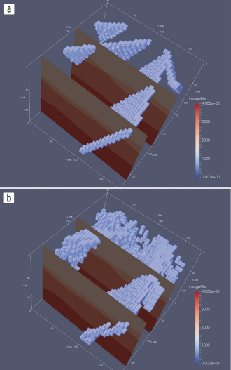
Automated Fault Detection Without Seismic Processing
The first diagram represents the ground
truth and the second represents the output
generated.

Slide 17
Automated Fault Detection Without Seismic Processing
Receiver Operating Characteristics (ROC) curves for representative DNN architectures.

Slide 18
Automatic salt-body classification using deep convolutional neural network
In this case, the authors consider salt body classification as an image segmentation problem, and propose to design a multi-layer convolutional neural network, feed in training data to train this network, and test the model using blind test data.
Salt boundary interpretation is important for understanding of salt tectonics and velocity-model building for seismic migration.
The framework of the proposed method is a convolutional encoder decoder network. It is designed to be an efficient architecture for pixel-wise semantic segmentation.
Element-wise rectified-linear unit (σ(x) = max{0, x}) is applied as non-linear activation. Following that, they perform max-pooling and the resulting output is sub-sampled by a factor of 2. Max-pooling achieves translation invariance over small spatial shifts in the input image. The appropriate decoder in the decoder network upsamples its input feature maps by resizing-interpolation

Slide 19
Automatic salt-body classification using deep convolutional neural network
They train and test the network using SEAM Phase 1 dataset
First test the performance of the trained model at different crossline slices
Use the Cross Entropy loss as the objective function, and adaptive momentum descent (Adam) as optimization algorithm
After 200 epochs of training, the model achieves 80.77% global accuracy (the percentage of pixels correctly classified in the image). The salt likelihood is the probability output of the softmax classifier, and the predictions are assigned by maxlikelihood class. Compared to the ground truth, the training accuracy is nearly as good as the human interpretation.

Slide 20
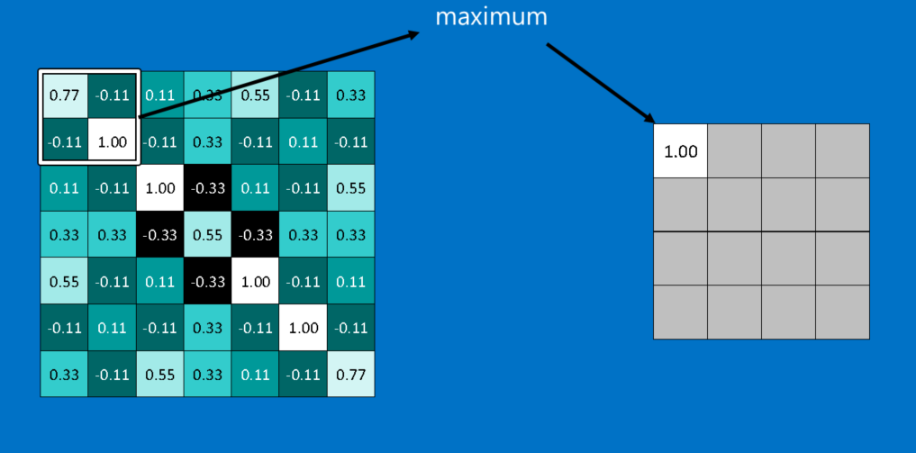
Automatic salt-body classification using deep convolutional neural network
Pooling in CNN

Slide 21
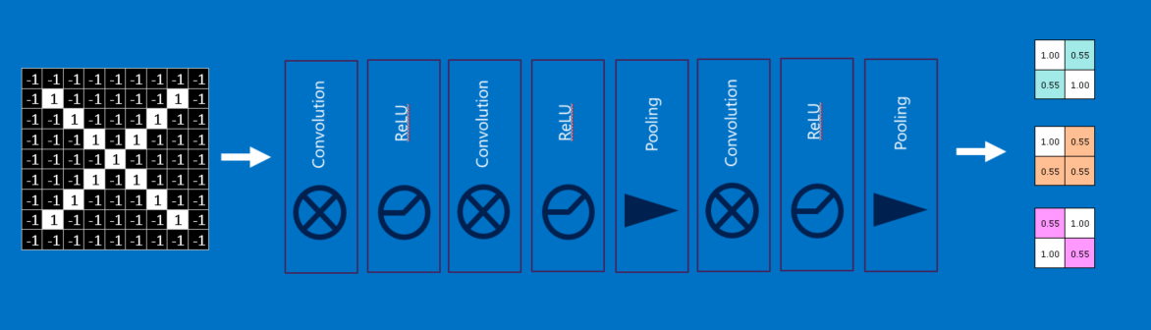
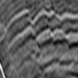
Automatic salt-body classification using deep convolutional neural network

Slide 22
Module Specification

Slide 23
Dataset

Slide 24
Data Preprocessing
Our approach aims at automatically identifying and delineating geological elements from seismic data.
The dataset we have obtained contains a set of PNG files, each image having a resolution of 101 x 101. Since we are using a U-Net we will need to convert each of them to 128 x 128.
The images in the dataset are compressed using Run-Length encoding, which is a form of lossless data compression in which runs of data (that is, sequences in which the same data value occurs in many consecutive data elements) are stored as a single data value and count, rather than as the original run.

Slide 25
Plot the depth distribution in the training data
Our data analysis phase receives as input a body of seismic data with the task of automatically identifying salt regions. We randomly sample a small fraction (0.5%) of the total data.
Achieve a class-balanced problem, we plan to make sure exactly one half of the subset corresponded to salt, and the other half as non-salt (the task exhibited equal class priors).
We plot the values of the depth attribute indicating how deep most of the salt bodies. This will help us generalize saying that most salt bodies lie in x to y range.

Slide 26
Plot the proportion of salt vs depth in the training data
Apply masks on the images as the masks are easier to process by the neural network than the raw images.
Masks will be in black and white; making it easier to detect where salt is present and where it isn’t

Slide 27
Building the U-Net algorithm
U-Net is considered one of standard architectures for image classification tasks, when we need not only to segment the whole image by its class, but also to segment areas of image by class
U-Net predicts a pixel wise segmentation map of the input image rather than classifying the input image as a whole. For each pixel in the original image, it asks the question: “To which class does this pixel belong?’’

Slide 28
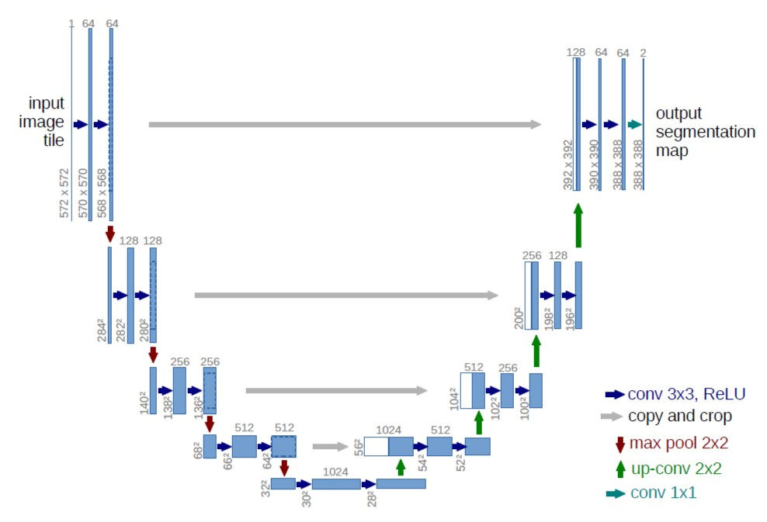
Building the U-Net algorithm

Slide 29
CONCLUSION
We present a novel approach to the challenging multistep seismic model-building problem.Design and workflow of a network is made.
A distinguishing aspect of the solution is the use of the Wasserstein loss function, which is suited to problems in which the outputs have spatial layout dependency.

Slide 30
CONCLUSION
The application of machine learning approaches to seismic imaging and interpretation shows great promise in hydrocarbon exploration and can dramatically change how the vast amount of seismic data is used in the future.

Slide 31
THANK YOU

